Slide 1
Descriptive Analytics
Introduction. Data collection

Slide 2
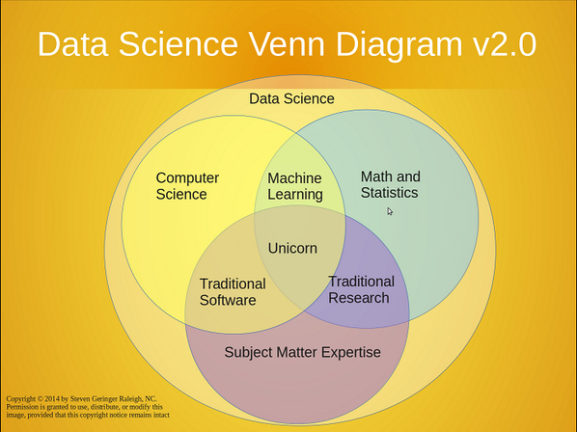

Slide 3

Customer Analytics - Introduction
Who are our customers?
What do they need?
What do they want?
What should we do?
Business Intelligence
Predictive analytics
Unsupervised methods
Time series analysis
Statistics
Probability theory

Slide 4
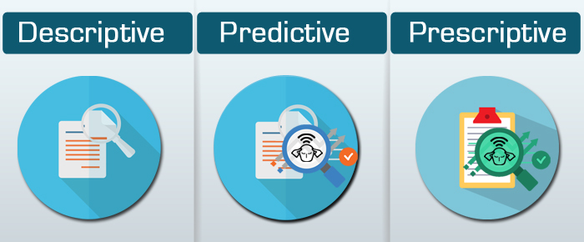
Types of Analytics
Descriptive Analytics – What has happened?
Predictive Analytics – What might happen?
Prescriptive Analytics – What should we do?

Slide 5
Descriptive Analytics
Descriptive Research – Aware of Problem What are our sales? Who are our customers?
Exploratory Research – Ambiguous Problem Our sales are down – Why?
Causal Research – Problem Clearly Defined Do we get higher sales if we change packaging?

Slide 6

Garbage In, Garbage Out
Your analysis is as good as your data.

Slide 7
Data collection
Exploratory Research
Focus groups
Online communities
Descriptive Research
Surveys
Self-reporting
Panel data
Scanner data
Mobile, Web data
Causal Research
Experiments

Slide 8

Data collection
Exploratory Research
Focus groups
Online communities
Descriptive Research
Surveys
Self-reporting
Panel data
Scanner data
Mobile, Web data
Causal Research
Experiments

Slide 9

Focus groups
Qualitative research data gathering technique
Moderated unstructured discussion between diverse group of people
Members discuss some topics and allowed to influence each other
“Aha!” moment
Slow and expensive

Slide 10
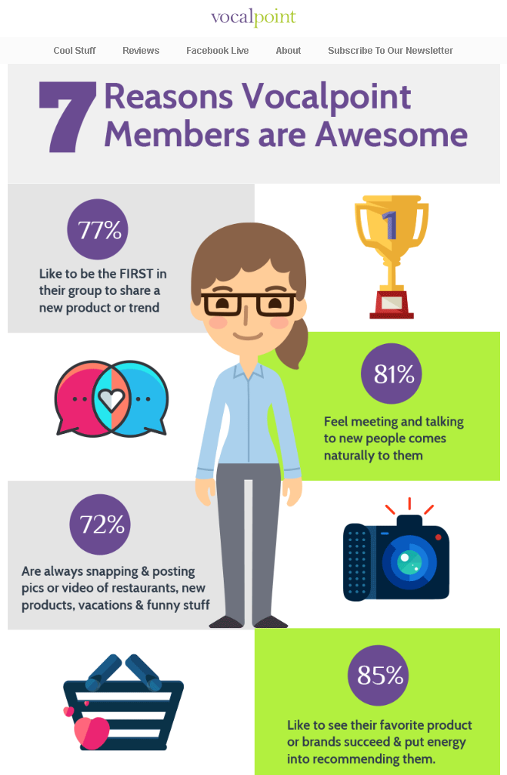
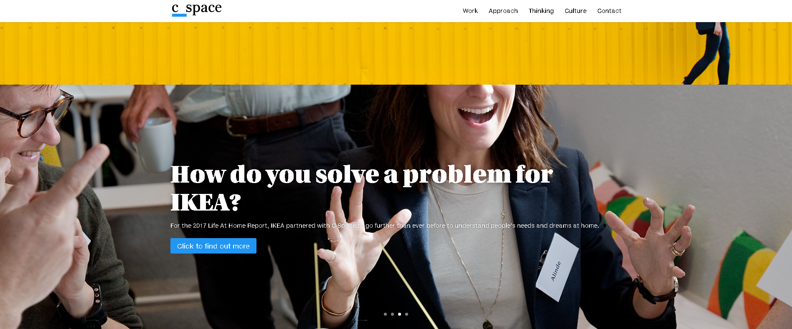
Online communities
Working with C Space, IKEA:
Ran online communities in seven core, globally representative countries (USA, China, India, Denmark, Germany, Japan and Russia)
Surveyed more than 21,000 people across 22 countries to robustly validate insights and hypotheses

Slide 11

Data collection
Exploratory Research
Focus groups
Online communities
Descriptive Research
Surveys
Self-reporting
Panel data
Scanner data
Mobile, Web data
Causal Research
Experiments

Slide 12
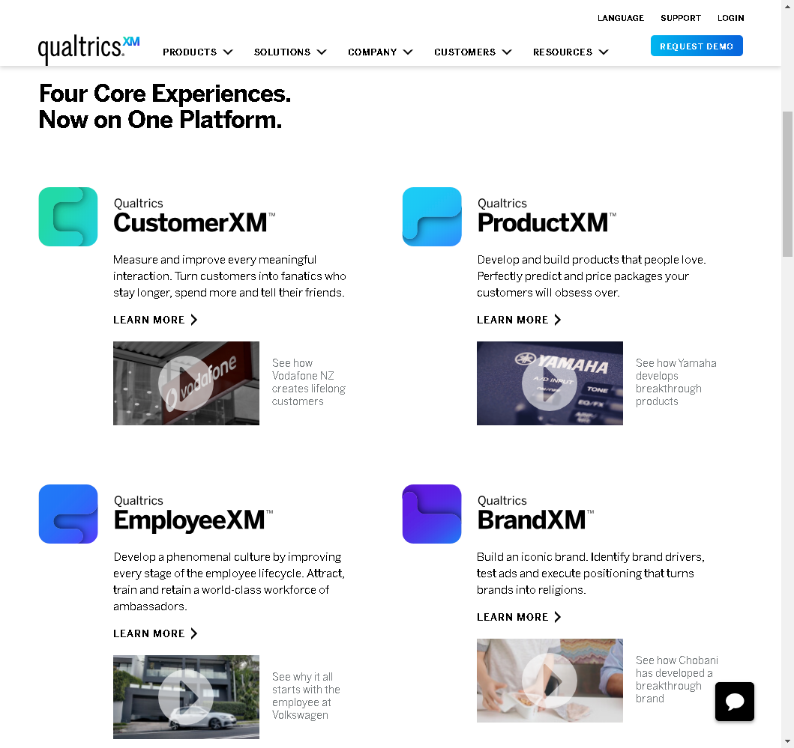
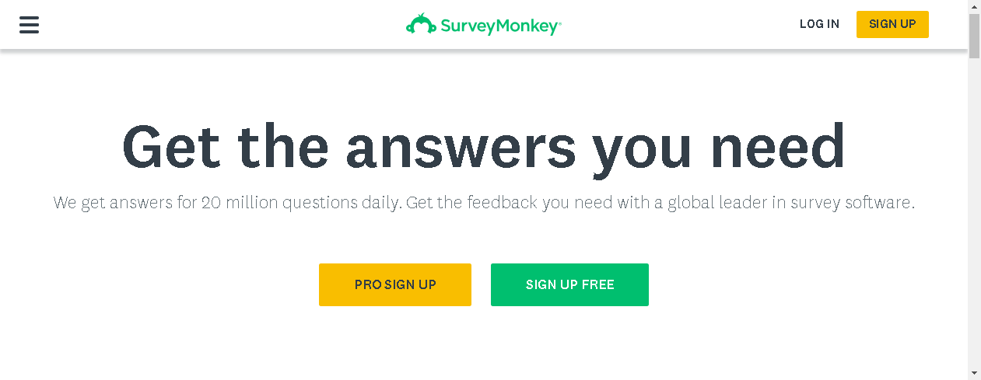
Surveys
Face-to-face
Mailout
Online

Slide 13
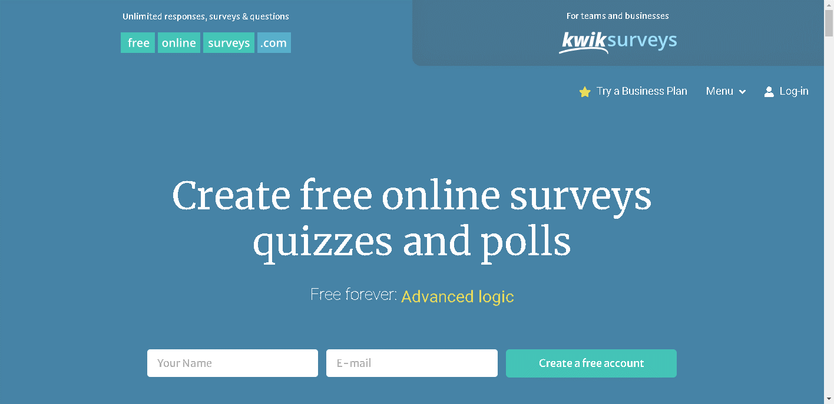

Slide 14
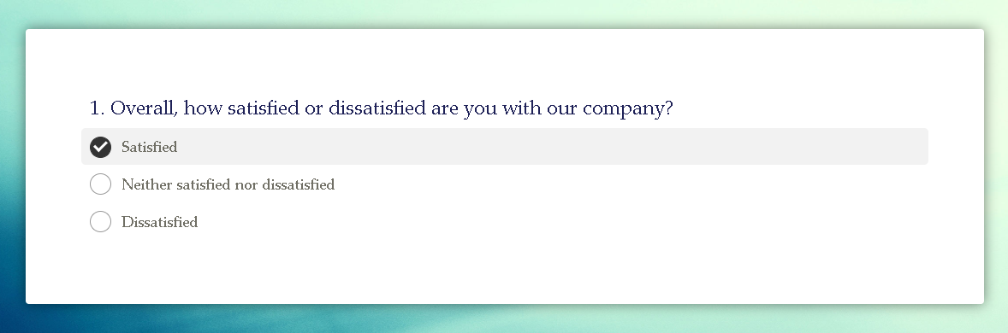

Surveys

Slide 15
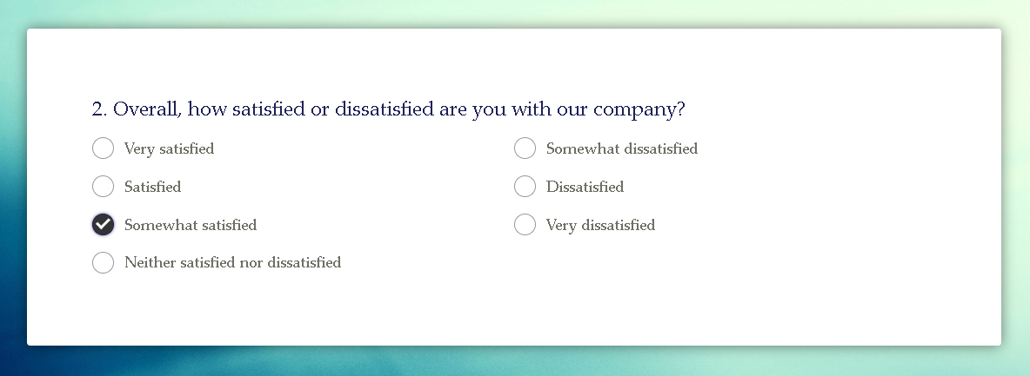
Surveys

Slide 16
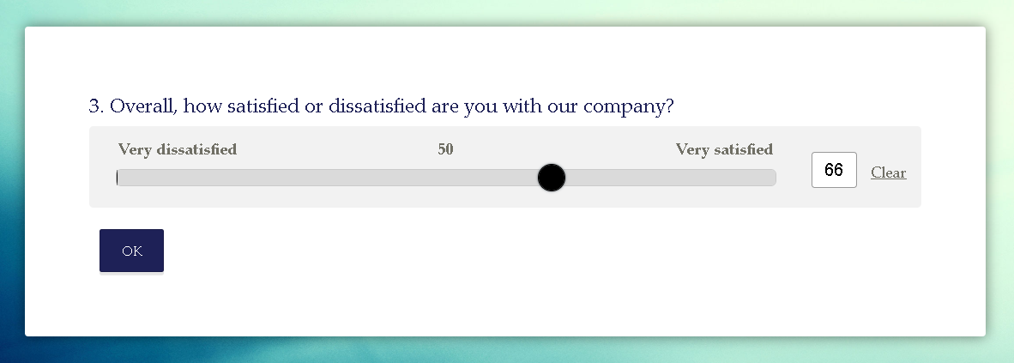
Surveys

Slide 17
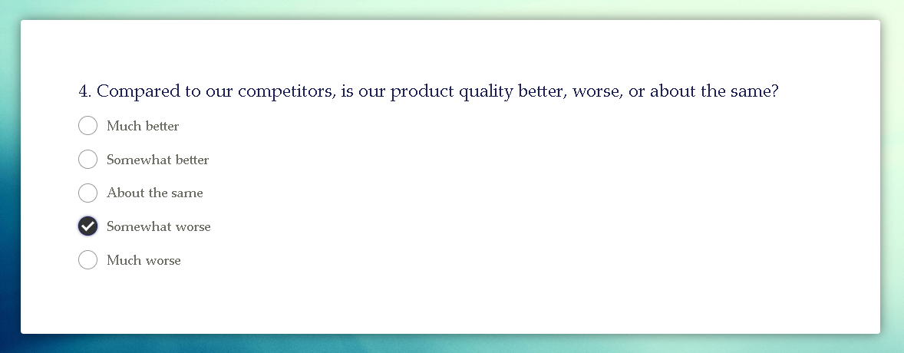
Surveys

Slide 18
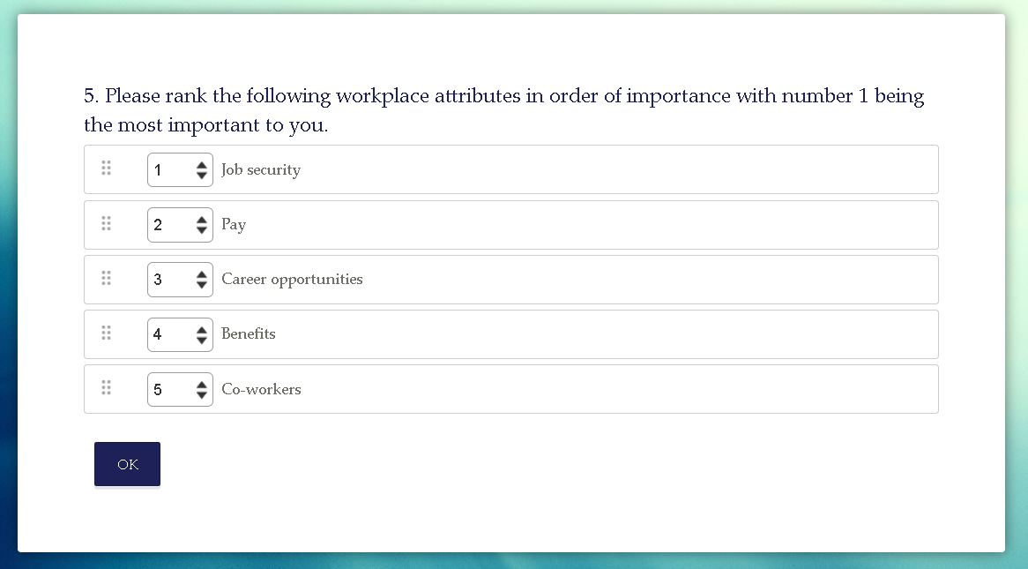

Slide 19
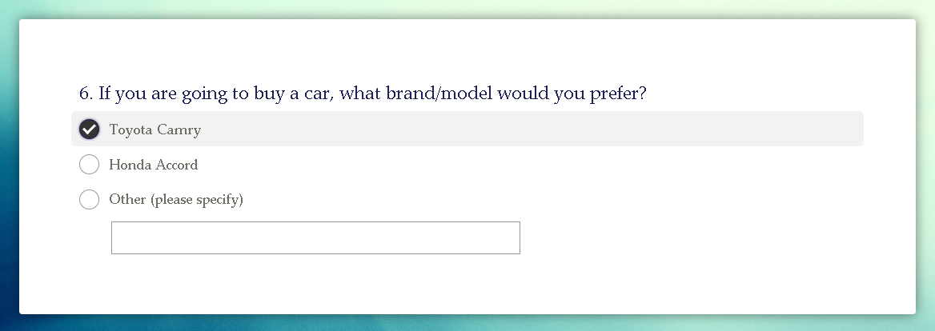
Surveys

Slide 20
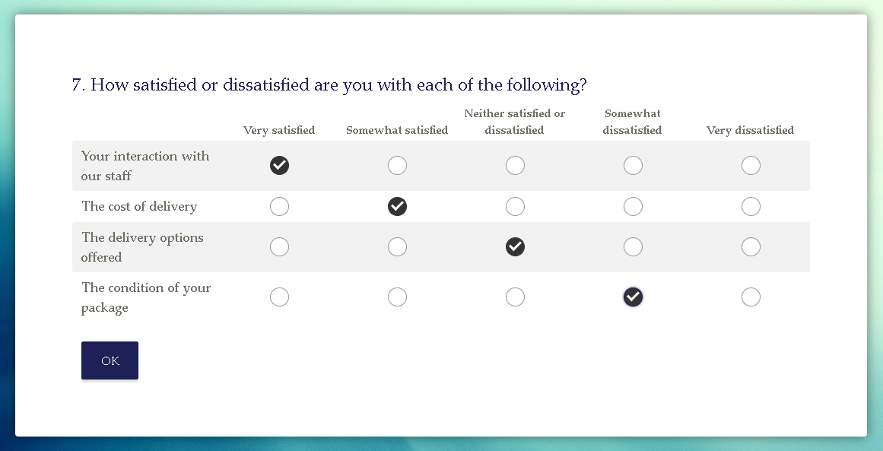

Slide 21
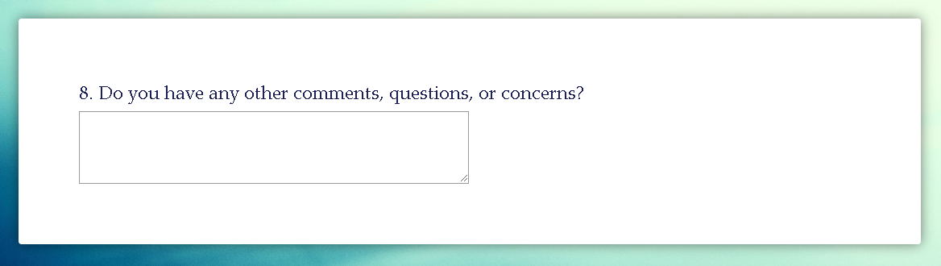
Surveys

Slide 22
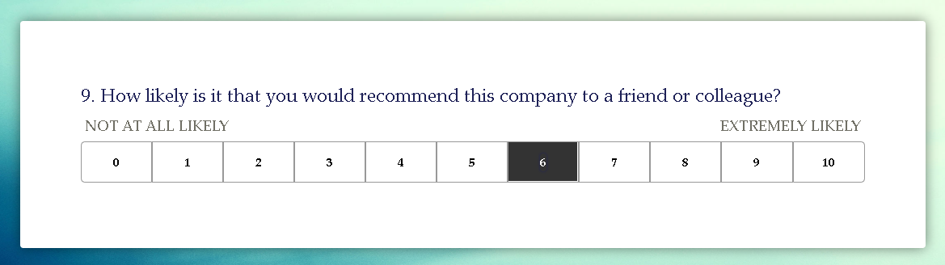
Surveys – Net Promoter Score (NPS)
Promoters (9-10); Passives (7-8); Detractors (0-6)
$$NPS = Percentage of Promoters − Percentage of Detractors$$

Slide 23

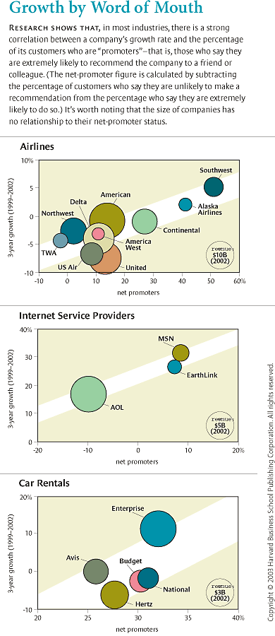
Net Promoter Score (NPS)
The One Number You Need to Grow
by Frederick F. Reichheld
https://hbr.org/2003/12/the-one-number-you-need-to-grow
American Customer Satisfaction Index (ACSI);

Slide 24
Net Promoter Score (NPS)
Some questions to consider while evaluating NPS:
Is customer satisfaction is correlated to profitability? E.g. WaterSA and Ambulances Australia
Profitability is potentially unlimited [linear], while satisfaction can not be lower than 0 and higher than 100 percent [s-curve, logistic curve].

Slide 25
Net Promoter Score (NPS)
American Customer Satisfaction Index (ACSI)
On a scale 1 to 10: Overall satisfaction, Expectancy disconfirmation, Comparison to an ideal
Net Value Score (NVS)
How would you rate COMPANY X on the total value the company offers, compared to the total value offered by other suppliers of similar products/services?
Customer Satisfaction Score (CSAT)
Were you satisfied with our service today? (YES / NO)
9 Mysterious Customer Success Metrics to boost business growth https://survicate.com/customer-success/cs-metrics/

Slide 26
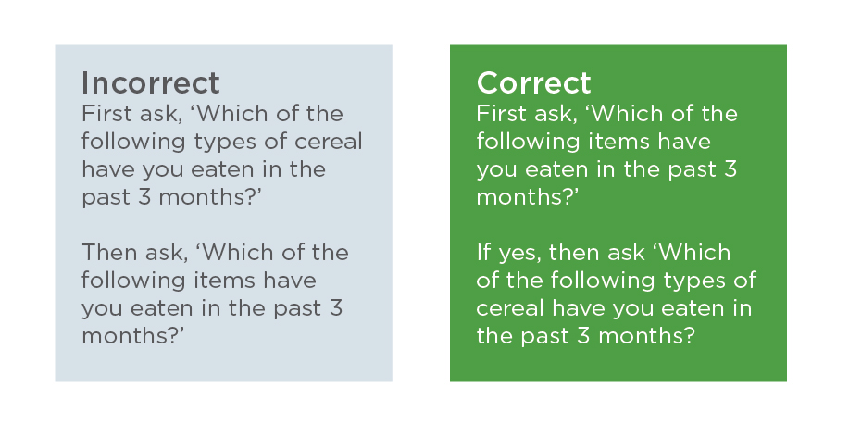
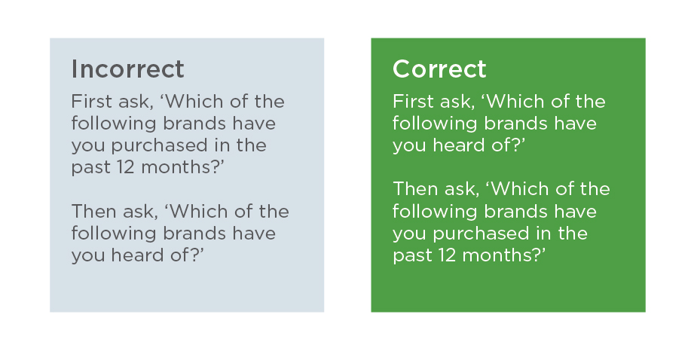
Survey Design
Do we ask right questions?
Do we collect right data?
Two important characteristics:
Predictive validity – data make good predictions for variables of interest
Test-retest reliability – if we are to re-measure, do we get the same result?
https://www.researchnow.com/blog/10-best-practices-survey-screening/?lang=gb

Slide 27
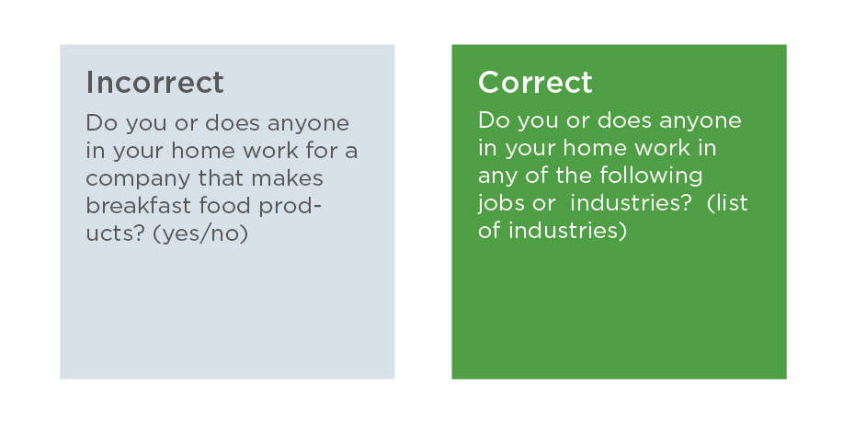
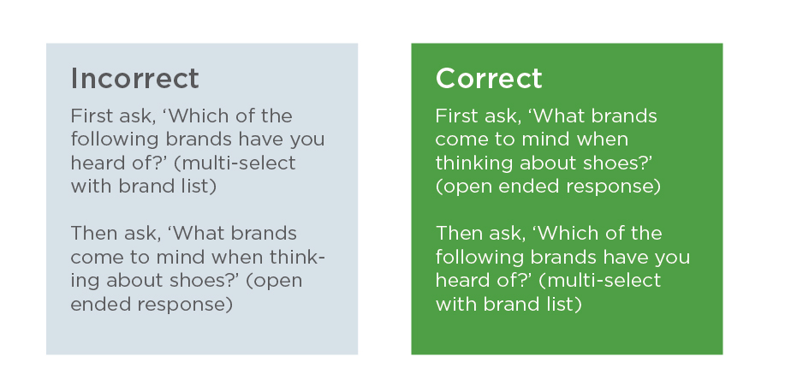
Survey Design
Mode of Data Collection
Impact of Survey Fatigue
The Effect of Survey Question Wording
How You Order Your Questions
Different Survey Question Formats
Accuracy of the Answers You Receive
Bias in Self-Reported Behavior
Survey Analysis Plan
https://www.researchnow.com/blog/10-best-practices-survey-screening/?lang=gb

Slide 28
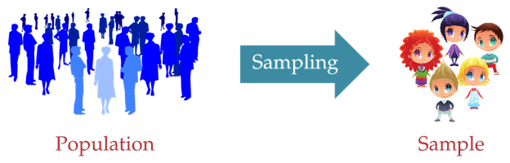
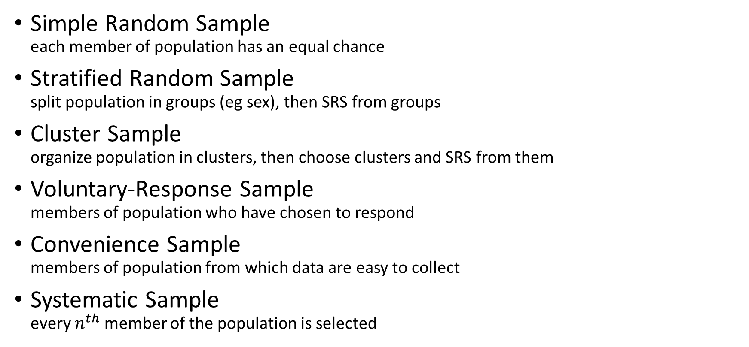
Sampling Techniques
Simple Random Sample each member of population has an equal chance
Stratified Random Sample split population in groups (eg sex), then SRS from groups
Cluster Sample organize population in clusters, then choose clusters and SRS from them
Voluntary-Response Sample members of population who have chosen to respond
Convenience Sample members of population from which data are easy to collect
Systematic Sample every $n^{th}$ member of the population is selected

Slide 29
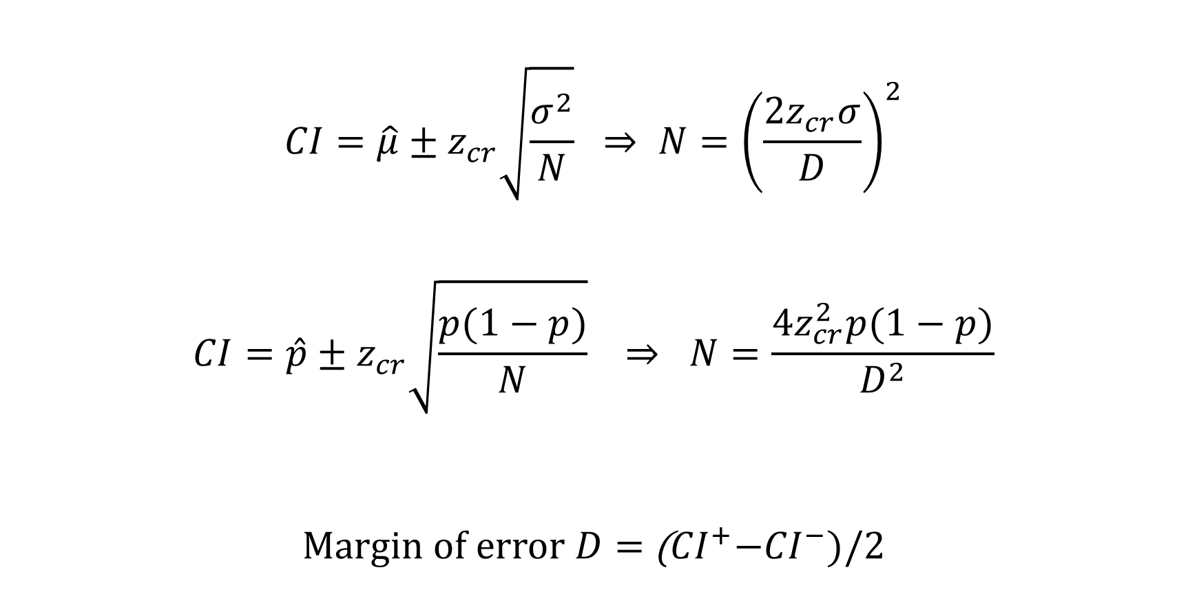
Sample Size
$$CI=\hat{μ}±z_{cr}\sqrt{\frac{σ^{2}}{N}} ⇒ N={\left(\frac{2z_{cr}σ}{D}\right)}^{2}$$
$$CI=\hat{p}±z_{cr}\sqrt{\frac{p(1−p)}{N}} ⇒ N=\frac{4z_{cr}^{2}p(1−p)}{D^{2}}$$
Margin of error $D=$ (${CI}^{+}{−CI}^{−})/2$

Slide 30
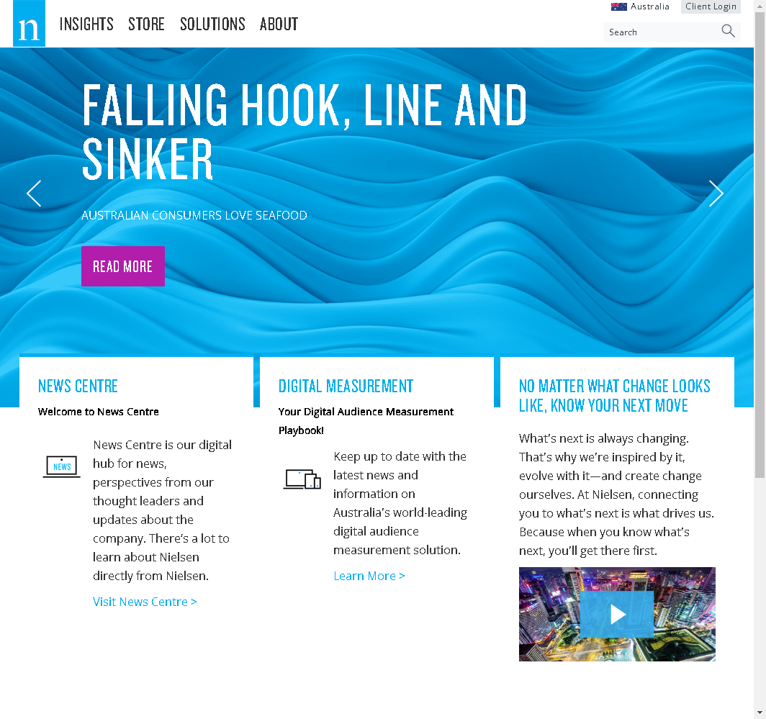
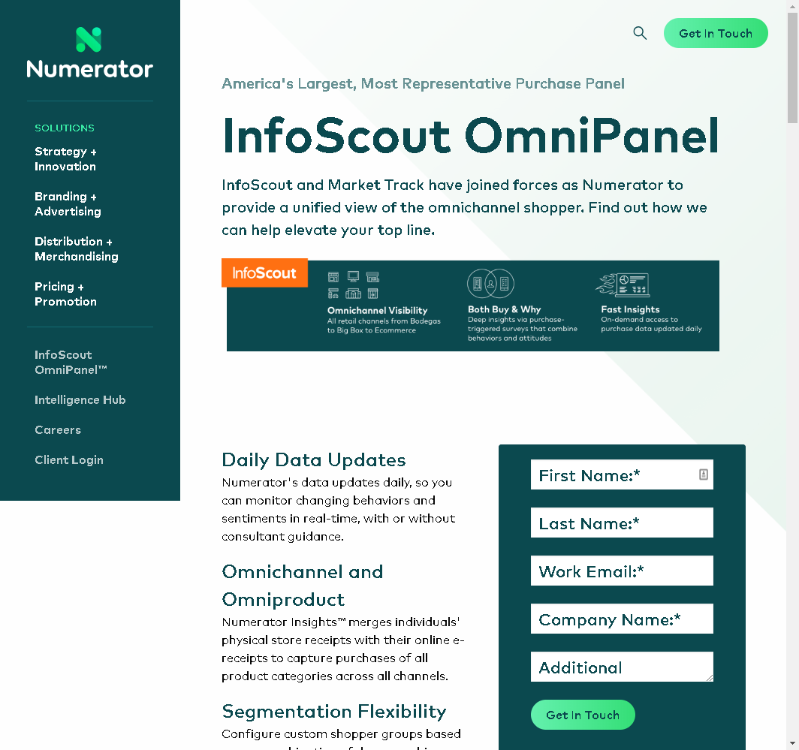
Self-reporting, panel data

Slide 31
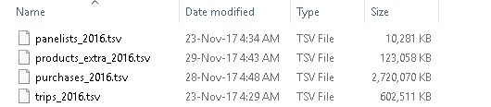
Self-reporting, panel data
Panel of customers representing different demographic groups
Report all purchases
Purchase trigged surveys
Mobile surveys
Nielsen US Panel 2016
63,150 households
10,745,635 shopping trips
67,767,386 purchases
4,231,283 SKUs

Slide 32







Passive data collection
Scanner data
Media planning – radio, TV audience
Social Media Analysis – Facebook, Twitter, Instagram
Mobile data – Facebook, Foursquare, coupon services
Web data – web logs, Google

Slide 33
Scanner data – Pros and Cons
Completeness
Timeliness
Accuracy
Misses out on convenience stores and even some big retailers (Aldi, Whole Foods)
Cannot make causal statements
Don’t know behaviors and psychographics
Don’t know the exact set of choices faced by the consumer at the time of decision.

Slide 34
Scanner data – Assignments
An average size supermarket
About 1,000,000 transactions per month
36 months of data
Unique feature of the data – customer ID

Slide 35
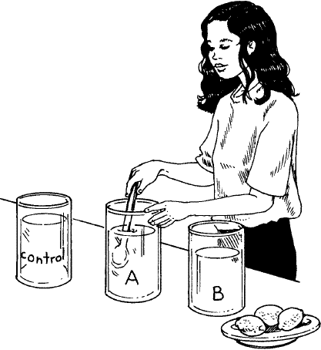
Data collection
Exploratory Research
Focus groups
Online communities
Descriptive Research
Surveys
Self-reporting
Panel data
Scanner data
Mobile, Web data
Causal Research
Experiments

Slide 36

Experiments and Field Tests
Scientific testing where specific variables and hypothesis can be tested
Controlled environment, where a set of variables are kept constant
Invariable behavior between cause and effect to establish a cause-effect relationship

Slide 37
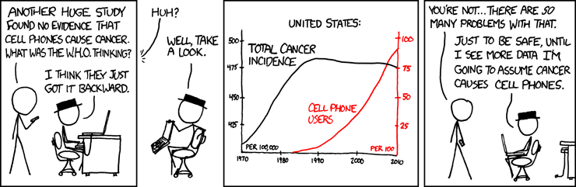
Correlation and Causation
Correlation - relationship between two variables.
Causation - one variable producing an effect in another variable.
© xkcd, 2014.

Slide 38
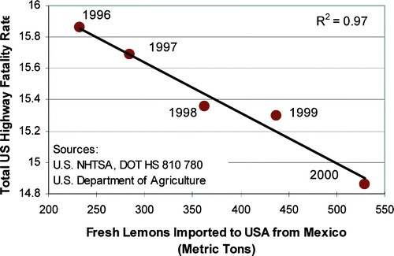
Causal Inference: Three Requirements
Correlation: Evidence of association between X and Y
Temporal antecedence: X must occur before Y
No third factor driving both: Control of other possible factors

Slide 39
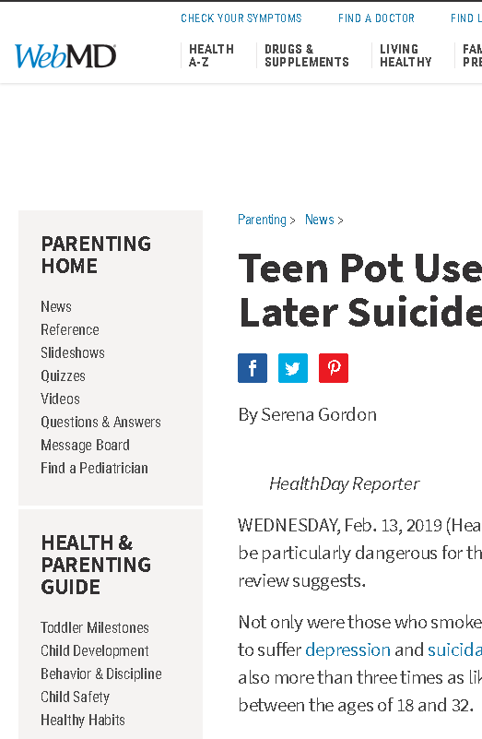
Teen Pot Use Raises Later Suicide Risk
WEDNESDAY, Feb. 13, 2019 (HealthDay News) -- Pot may be particularly dangerous for the teenaged brain, a new review suggests.
Not only were those who smoked marijuana more likely to suffer depression and suicidal thoughts, they were also more than three times as likely to attempt suicide between the ages of 18 and 32.
What isn't clear from the review is why. Does marijuana (cannabis) somehow affect the developing teen brain? Or might teens who were later diagnosed with depression or who later attempted suicide have been using the drug to self-medicate?
Regardless, teens and preteens "should avoid using cannabis, as use is associated with a significant increased risk of developing depression or suicidality in young adulthood," the Canadian researchers wrote.
https://www.webmd.com/parenting/news/20190213/teen-pot-use-linked-to-later-suicide-risk

Slide 40
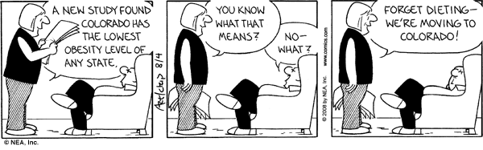
Summary
Types of analytics: descriptive, predictive, prescriptive
Types of descriptive analytics:
descriptive research, exploratory research, causal research
Data collection for each type of research. Active/passive data collection
Focus groups, online communities
Survey, self-reporting, panel data, scanner data, online and mobile data
Experiments
Correlation vs Causality

Slide 41
Thank you

